Slide 1

Linear Algebra for AI
Today’s Agenda
What is Linear Algebra? Why is it important in AI?
Vectors and Scalars
Matrices and Matrix Operations
Identity, Transpose, and Inverse
Practical Applications in AI
Hands-On Practice
Kahoot(Quiz)

Slide 2
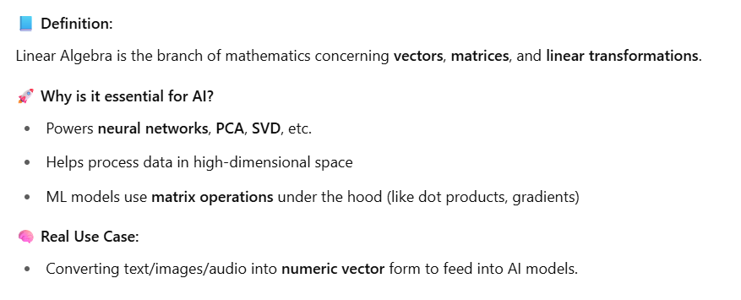
What is Linear Algebra? Why is it important in AI?
Notes:
sd

Slide 3
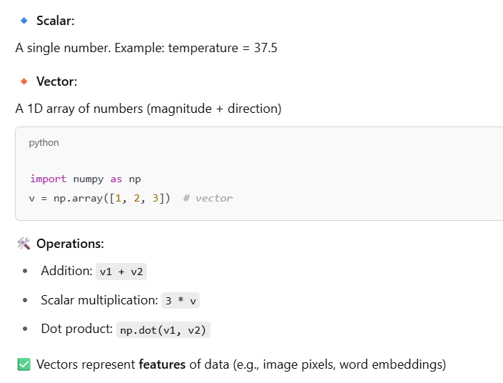
Scalars, Vectors, and Vector Operations

Slide 4
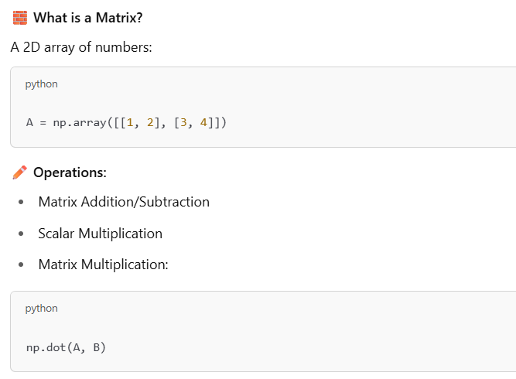
Matrices and Basic Matrix Operations

Slide 5
Short break

Slide 6
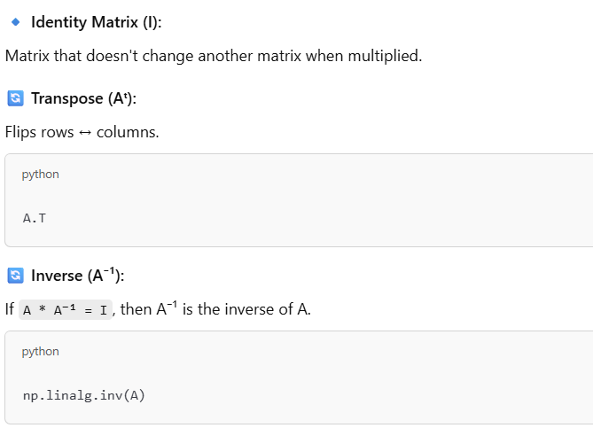
Identity, Transpose, and Inverse

Slide 7
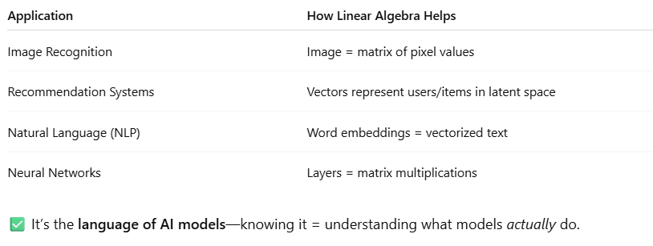
Linear Algebra in AI – Real World Usage

Slide 8
Main Break

